Slide 1
Server-side Programming
Routes in Flask

Slide 2
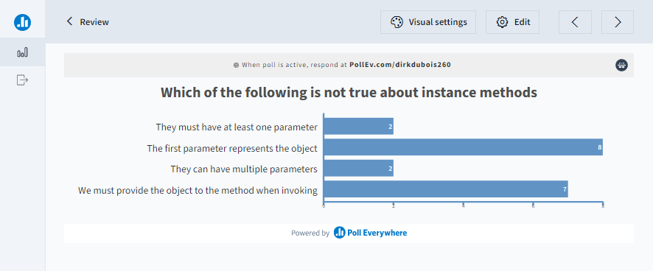
Let’s review

Slide 3
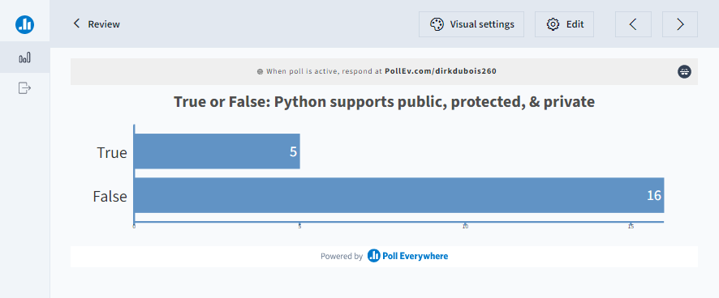
Let’s review

Slide 4
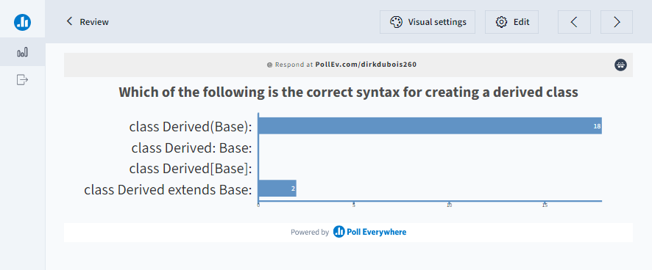
Let’s review

Slide 5
Recall what is a Uniform Resource Locators (URL)
Provides a link to a resource you want to retrieve
Works like an address to a piece of information on a server
Describes the protocol and how to retrieve info

Slide 6



Recall the pieces of a URL

Slide 7

Web-servers process the URL

Slide 8
Routes determine what loads for a given URL
@app.route tells Flask call the given function for the provided route
All routes start from the root path ‘/’
Undefined routes return a 404
@app.route('/')
def index():
return 'Index Page'
@app.route('/hello')
def hello():
return 'Hello, World'

Slide 9
Let’s create a url to show all the posts
Create a global list called posts that contains some sample posts
Modify app.py to contain a function called get_posts() its route should be /posts
Render the posts list

Slide 10
Routes can be dynamic
Variables in Flask URLs allow us to parameterize URLs
<> notation is used to create a variable in a URL
<int:value> can create a variable with a particular type
Variables in the URL become parameters in the function
@app.route('/post/<int:post_id>')
def show_post(post_id):
# show the post with the given id, the id is an integer
return f'Post {post_id}'

Slide 11
Different variables are available
Data type | Description
string | (default) accepts any text without a slash
int | accepts positive integers
float | accepts positive floating point values
path | like string but also accepts slashes
uuid | accepts UUID strings
@app.route('/user/<username>')
def show_user_profile(username):
# show the user profile for that user
return f'User {escape(username)}'
@app.route('/path/<path:subpath>')
def show_subpath(subpath):
# show the subpath after /path/
return f'Subpath {escape(subpath)}'

Slide 12
Let's display a particular Post
Modify app.py and create a new function called get_post
Its route should be /post/<> which takes an integer representing the post_id
Find the associated post and display it

Slide 13
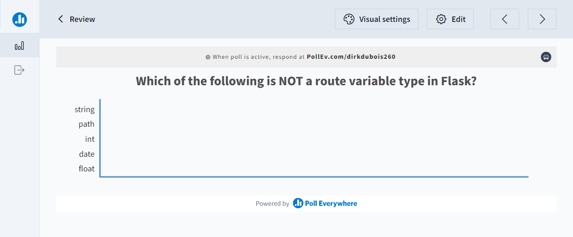
Let’s review

Slide 14
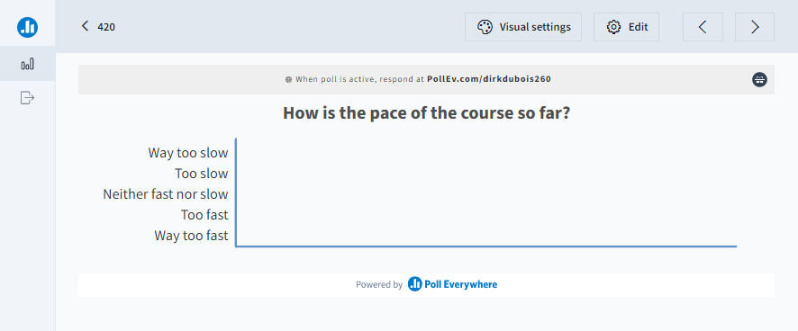
Let’s discuss

Slide 15
url_for returns the route for a given function
Provides a programmatic way to retrieve a route for a given function
Uses the functions name associated with a route to retrieve the path
Also provides a way to specific variables
@app.route('/post/<int:post_id>')
def show_post(post_id):
# show the post with the given id, the id is an integer
return f'Post {post_id}'
@app.route('/')
def index():
val = url_for('show_post', post_id=1)
return val

Slide 16
Redirection occurs on some URLs
Trailing slashes form the canonical URL
Navigating to a url without the trailing slash is not an issue, Flask will redirect you
Defining a route without the trailing slash, will prevent the redirect
@app.route('/projects/')
def projects():
return 'The project page'
@app.route('/about')
def about():
return 'The about page'

Slide 17
redirect function routes people programmatically
redirect takes a url
Routes the webserver to a new page
Redirect and url_for can be combined together
from flask import abort, redirect, url_for
@app.route('/about')
def about():
return 'The about page'
@app.route('/')
def index():
return redirect(url_for('about'))

Slide 18
Recall the HTTP status codes
HTTP Category | Status Codes
Informational responses | 100 – 199
Successful responses | 200 – 299
Redirection messages | 300 – 399
Client error responses | 400 – 499
Server error responses | 500 – 599

Slide 19
Common HTTP codes
Http code | Description
401 | Although the HTTP standard specifies "unauthorized", semantically this response means "unauthenticated". That is, the client must authenticate itself to get the requested response.
403 | The client does not have access rights to the content; that is, it is unauthorized, so the server is refusing to give the requested resource. Unlike 401 Unauthorized, the client's identity is known to the server.
404 | The server cannot find the requested resource. In the browser, this means the URL is not recognized. In an API, this can also mean that the endpoint is valid but the resource itself does not exist. Servers may also send this response instead of 403 Forbidden to hide the existence of a resource from an unauthorized client. This response code is probably the most well known due to its frequent occurrence on the web.

Slide 20
abort generates http errors
abort function takes http error codes
Returns a particular error to the user
Useful with parameterized URLs
@app.route('/login')
def login():
abort(401)
this_is_never_executed()
@app.route('/post/<int:post_id>')
def show_post(post_id):
post = get_post(post_id)
if post is None:
abort(404)
return f'Post {post}'

Slide 21
Handling error and redirects
Modify get_posts to return 404 if there are no posts
Modify get_post to redirect to get_posts if a post cannot be found

Slide 22
Creating custom error pages allows for personal branding
Flask has a decorator for indicating what functions should be called for a given error code
404 is the common page not found error, so let’s have a custom page
from flask import render_template
@app.errorhandler(404)
def page_not_found(error):
return render_template('page_not_found.html'), 404

Slide 23
Additional Resources
URLs : https://developer.mozilla.org/en-US/docs/Learn/Common_questions/What_is_a_URL
Webserver: https://developer.mozilla.org/en-US/docs/Learn/Common_questions/What_is_a_web_server
Http codes: https://developer.mozilla.org/en-US/docs/Web/HTTP/Status

